Slide 1
BUILDING E-COMMERCE WEBSITE ON SHOPIFY PLATFORM
Company : UrbanJet Hospitality Services Pvt.Ltd
Location : Nizampet, Hyderabad
Company Guide Submitted by
Mr. I.Chanakya Reddy K.Rama Krishna - 161FA04300
Faculty Guide B.Pavan Kumar - 161FA04283
Ms. Sajida Sultana. M.Ram Kishore - 161FA04456

Slide 2
CONTENTS
ABSTRACT
SCOPE
INTRODUCTION
SOFTWARE AND HARDWARE REQUIREMENTS
UML DIAGRAMS
SCREENSHOTS
APPS
REFERENCES

Slide 3
ABSTRACT
The project is associated with website development for building online stores using Shopify platform.
With the help of outcome of these project, the merchants can easily design, develop and deploy their own online stores with minimum effort and at reasonable cost with maximum profit potential.
As this project is developed on Shopify platform which is a global level platform, the store owners can sell their products to customers from foreign countries.
Hence, it helps in globalization of businesses.

Slide 4
Contd...
Shopify’s APIs let developers integrate with the platform in various ways.
Depending on the purpose of your app, you’ll first need to choose whether it will be public or private.

Slide 5
SCOPE
Generally to develop a website from scratch it takes lot of effort and time to complete.
Where as in Shopify with the help of themes and apps a website can be launched in single day with minimum effort and accuracy.
This platform also helps in tracking the orders and maintaining the stock details.
A website that is developed in Shopify can be changed dynamically by a store owner.

Slide 6
Contd...
But a regular website should need a web developer to maintain and make changes.
Since every business is trying to enter into e-commerce platform these apps will be very helpful to set up useful functionalities to the website. Thus it is going to have great demand in near future.

Slide 7
INTRODUCTION
Most shop owners don’t want the hassle of building a website from scratch and maintaining the tricky mechanics. They just want to sell their products. That’s where Shopify comes in.
Shopify is a Canadian e-commerce company. It is also the name of its proprietary e-commerce platform for online stores and retail point-of-sale systems.
Shopify is an e-commerce platform for creating online stores. The System is SaaS-based (Software as a service).

Slide 8
SOFTWARE and HARDWARE REQUIREMENTS
Software Requirements
Operating System | Windows 7 or higher / Mac OS X 10.5.8 or later / Linux
Platform | Shopify
Technologies used | Liquid, JSON, Java Script, Html
Hardware Requirements
Processor | Intel i3 or later
RAM | 512 MB or more
Hard disc | 250 GB or more

Slide 9
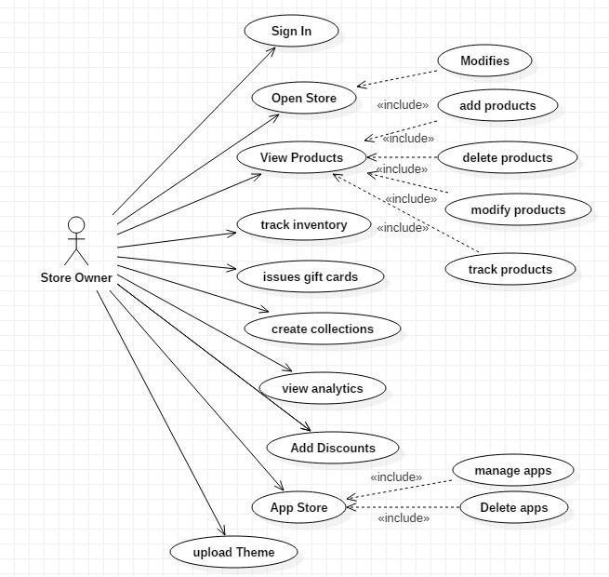
USE CASE DIAGRAM

Slide 10
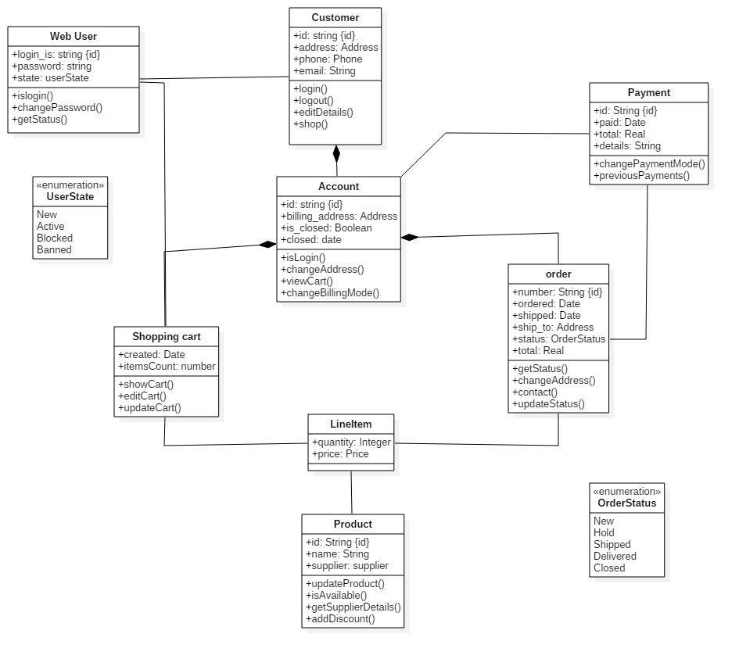
CLASS DIAGRAM

Slide 11
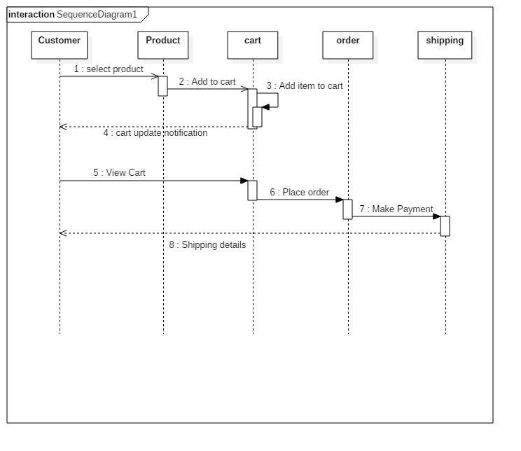
SEQUENCE DIAGRAM

Slide 12
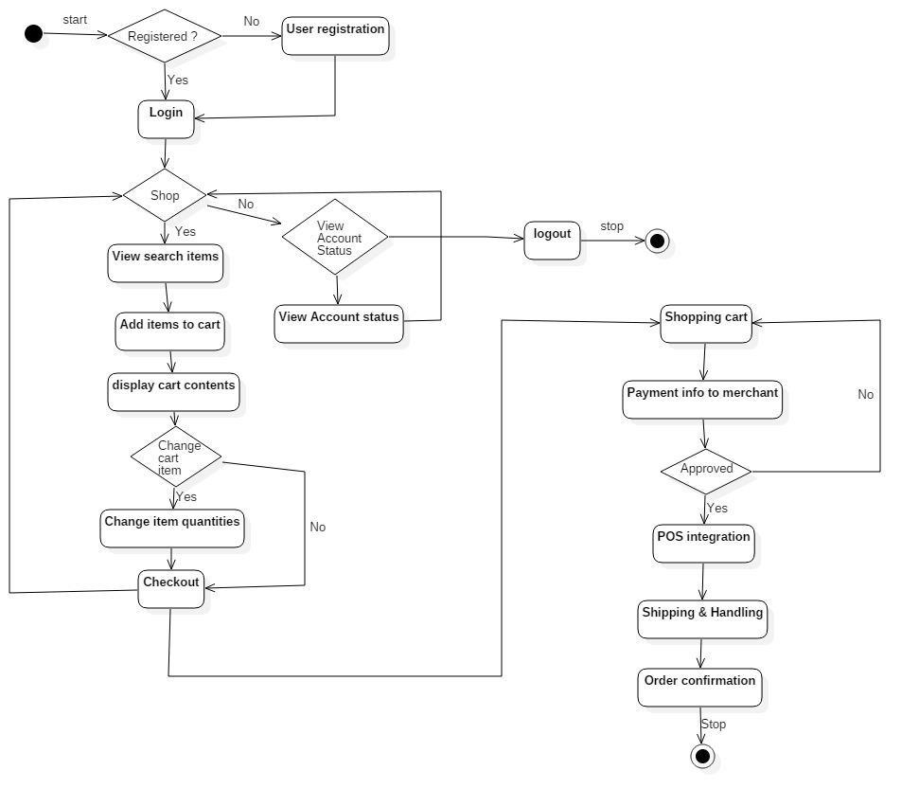
ACTIVITY DIAGRAM

Slide 13
SECTION BUILDING
There are three different ways to build a section that is
Full Screen Mode
Desktop Mode
Mobile Mode

Slide 14
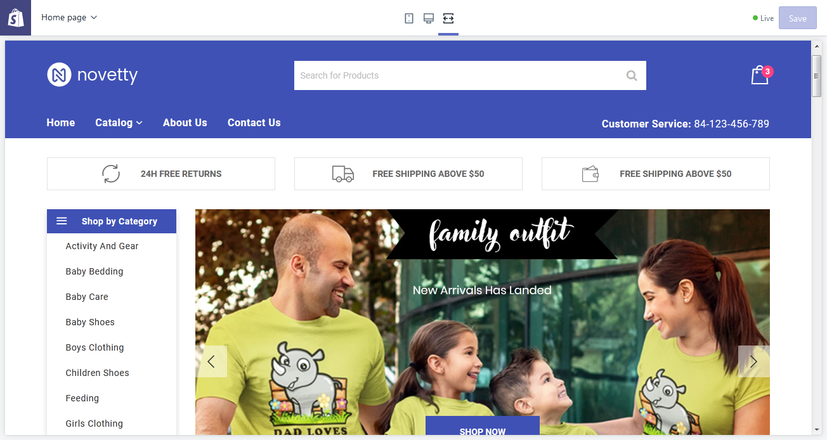
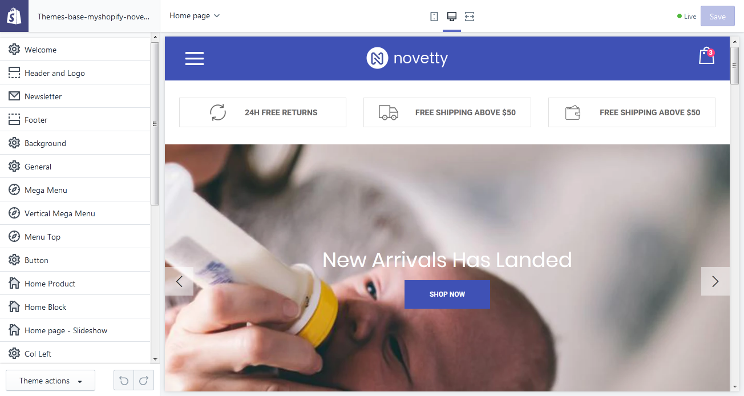

Slide 15
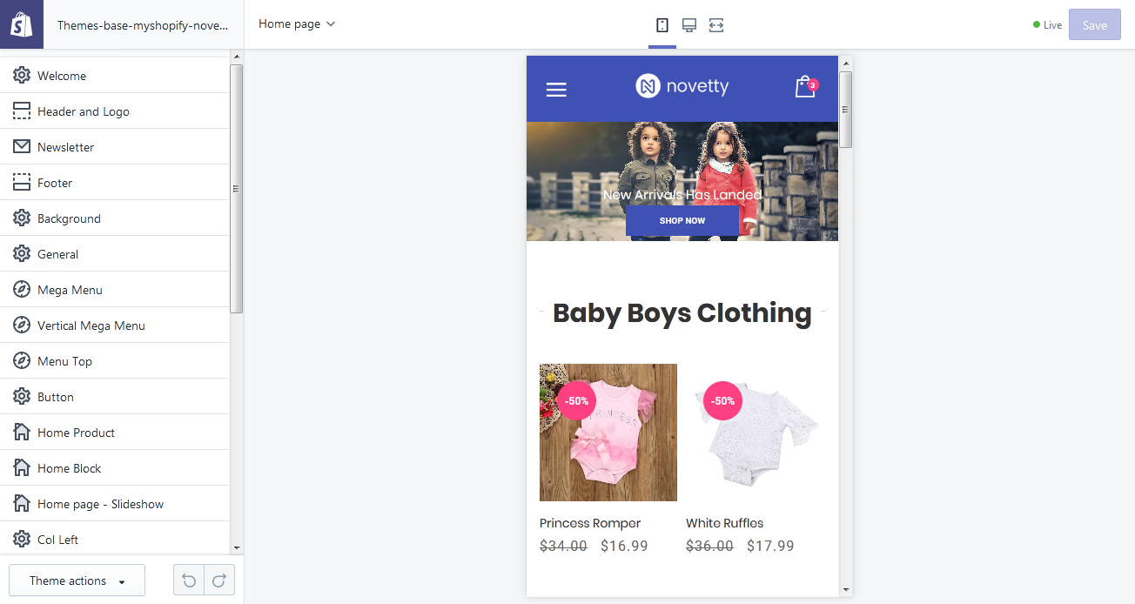

Slide 16
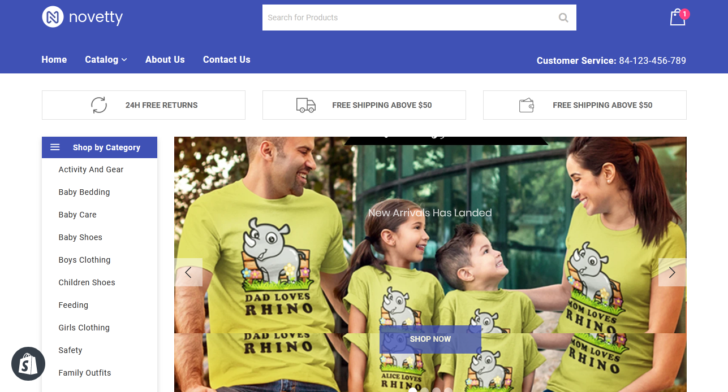
HOMEPAGE
The introductory page of a website, typically set as the default or start-up page on a browser when the website is visited.

Slide 17
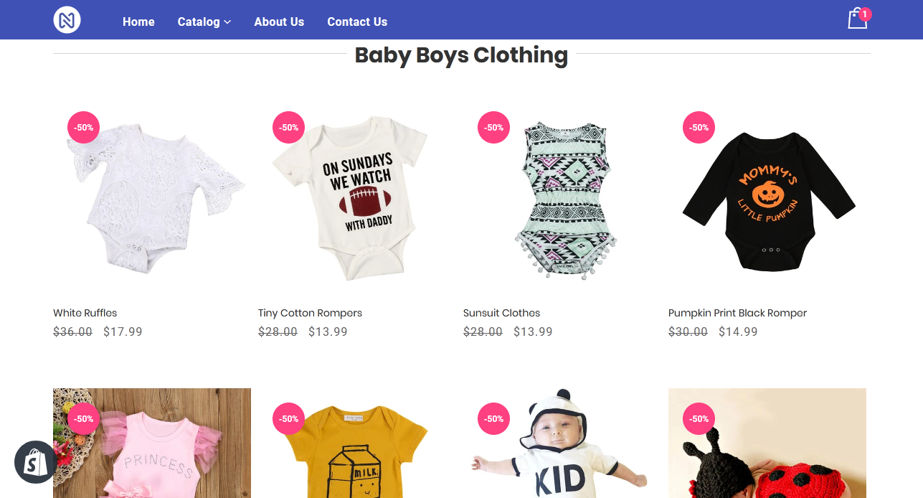
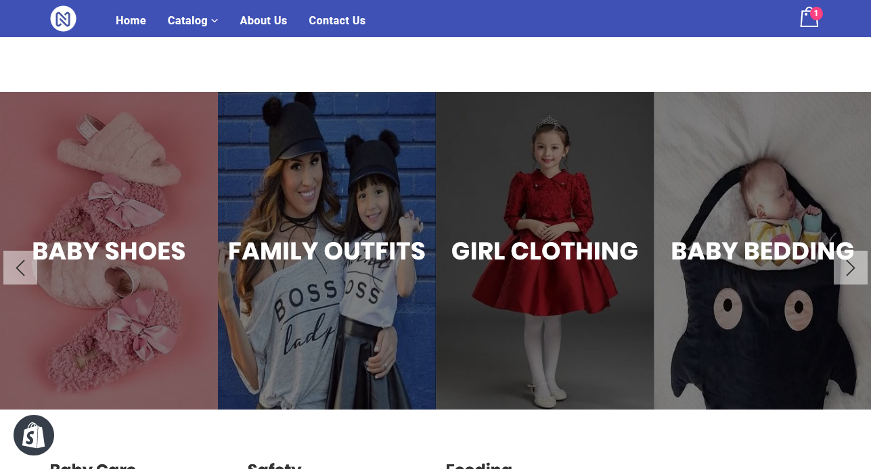
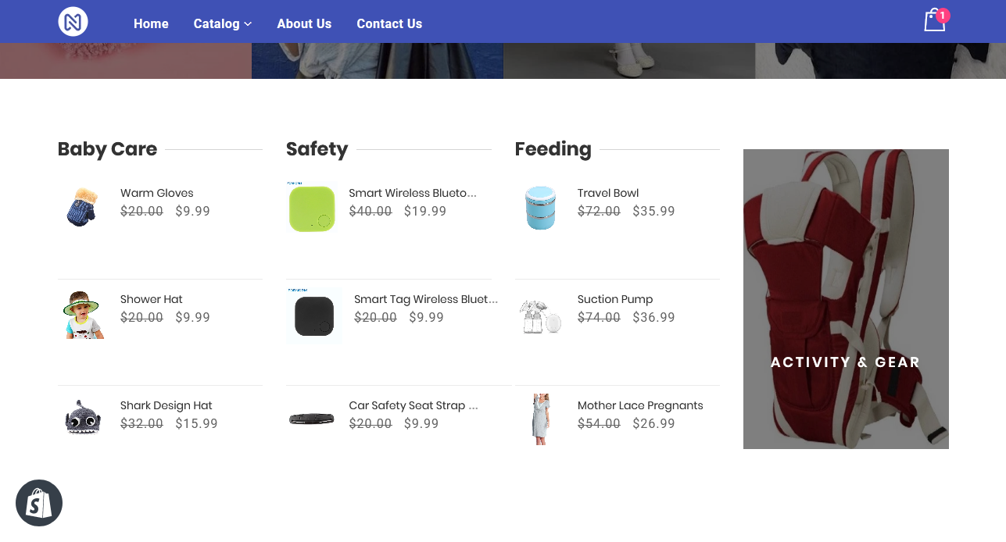
COLLECTIONS
Collections are great for gathering similar products into their own buckets or groups.

Slide 18
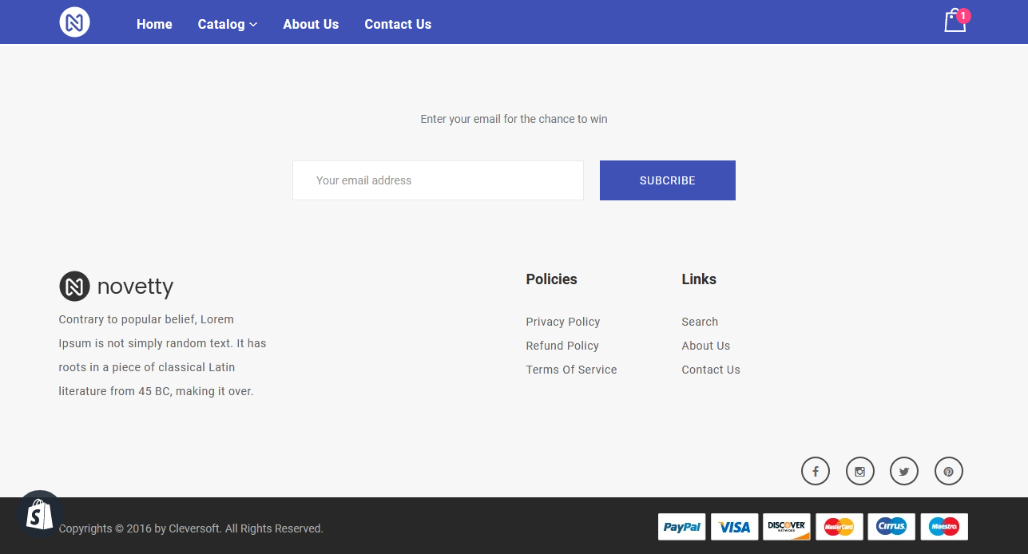
NEWSLETTER
With a newsletter signup, you collect email addresses from your customers and store them on the Email subscribers tab on the Customers page in the Shopify admin.

Slide 19
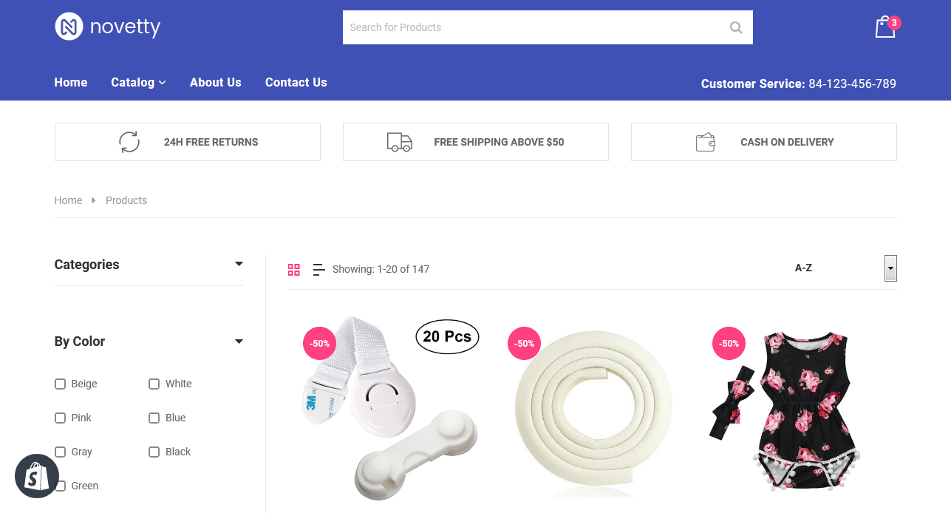
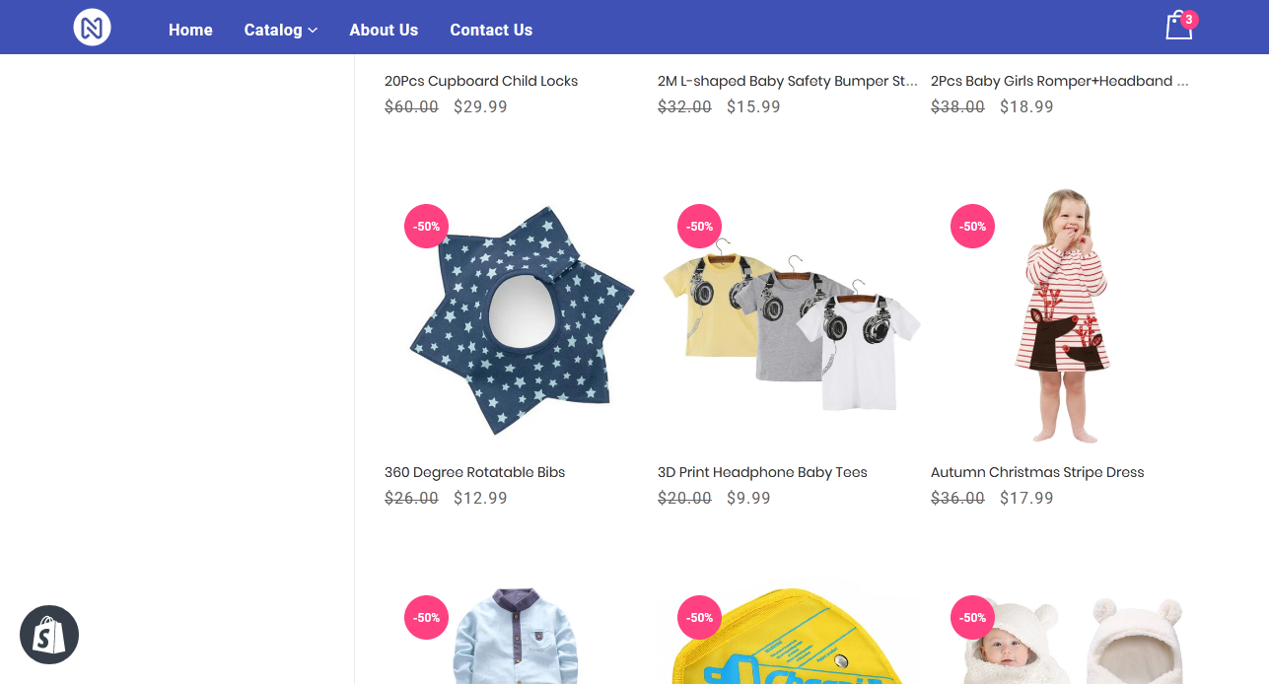
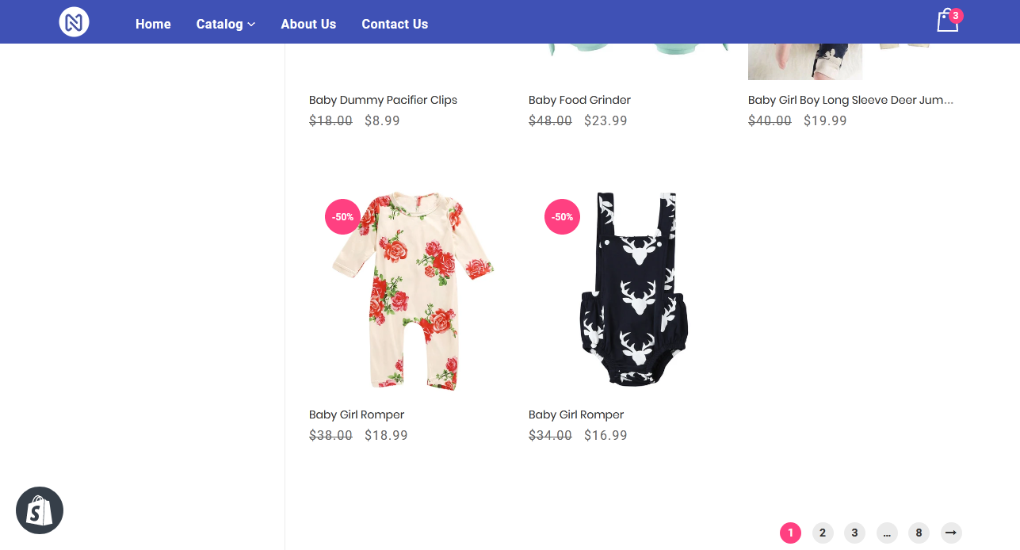
CATALOG
A complete list of items, typically one in alphabetical or other systematic order.

Slide 20
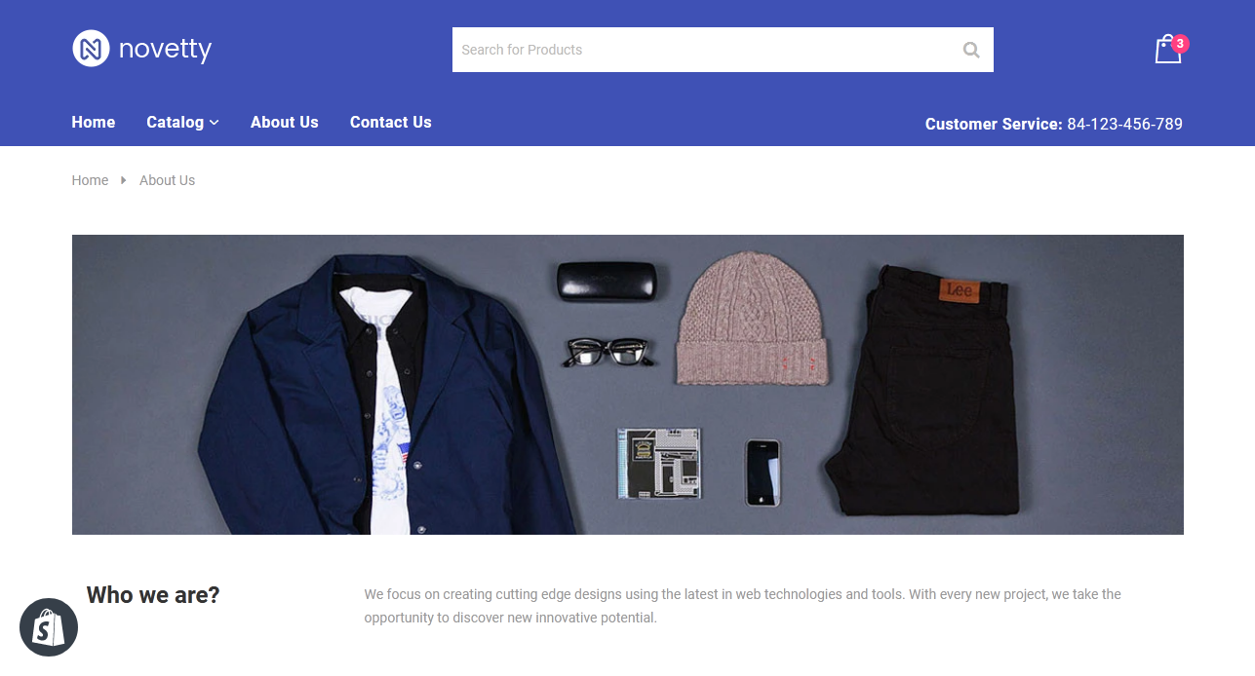
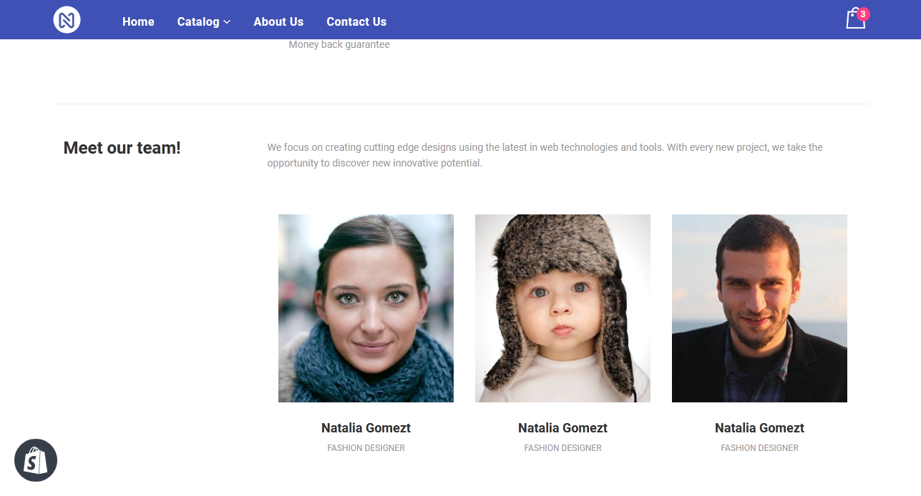
ABOUT US
The About us page is commonly used by all types of businesses to give customers more insight into who is involved with a given business, is often a reflection of the purpose and personality of the business and its owners or top employees.

Slide 21
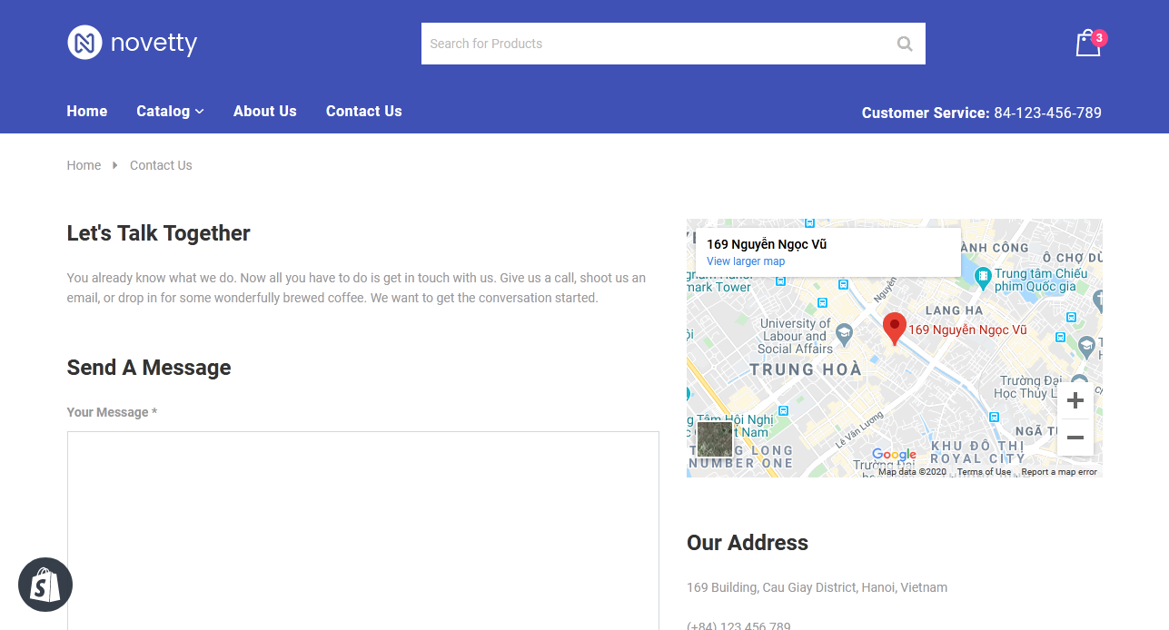
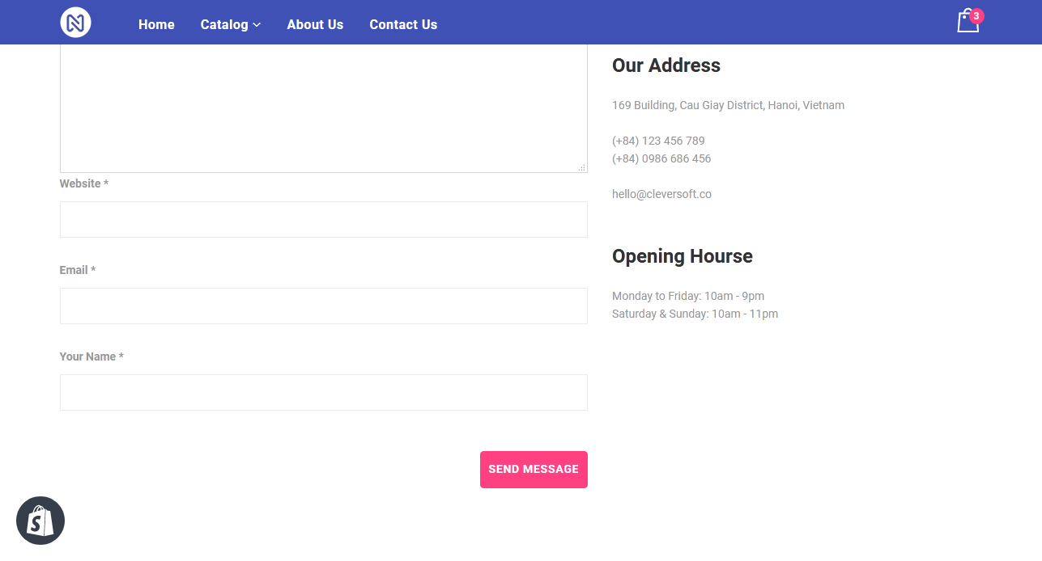
CONTACT US
A contact page is a website page that allows visitors to reach out to the website owner, customer support, or a person at the company.

Slide 22
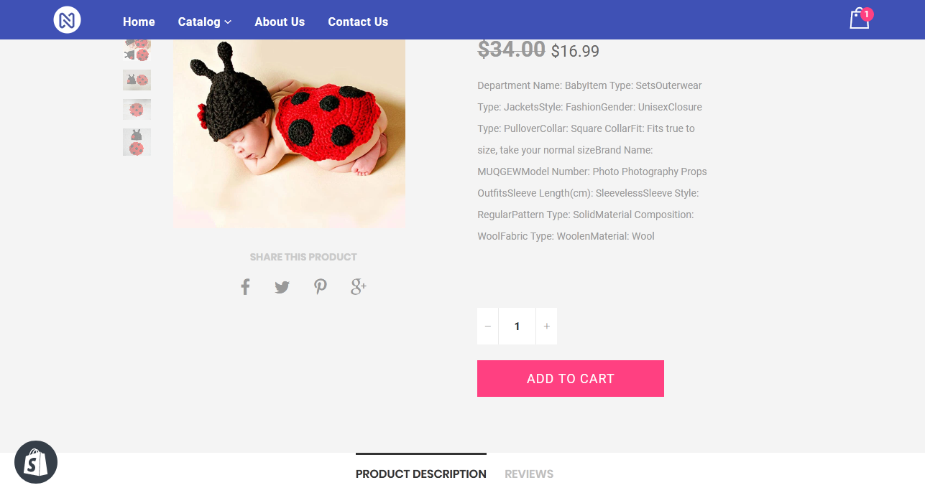
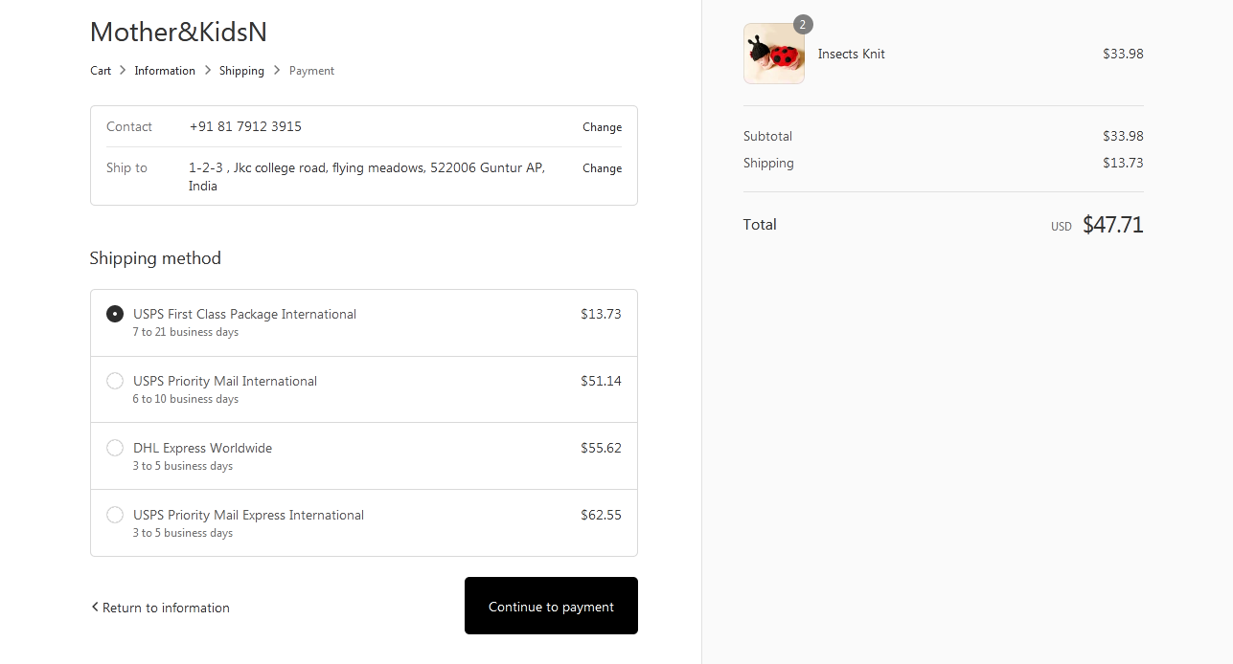
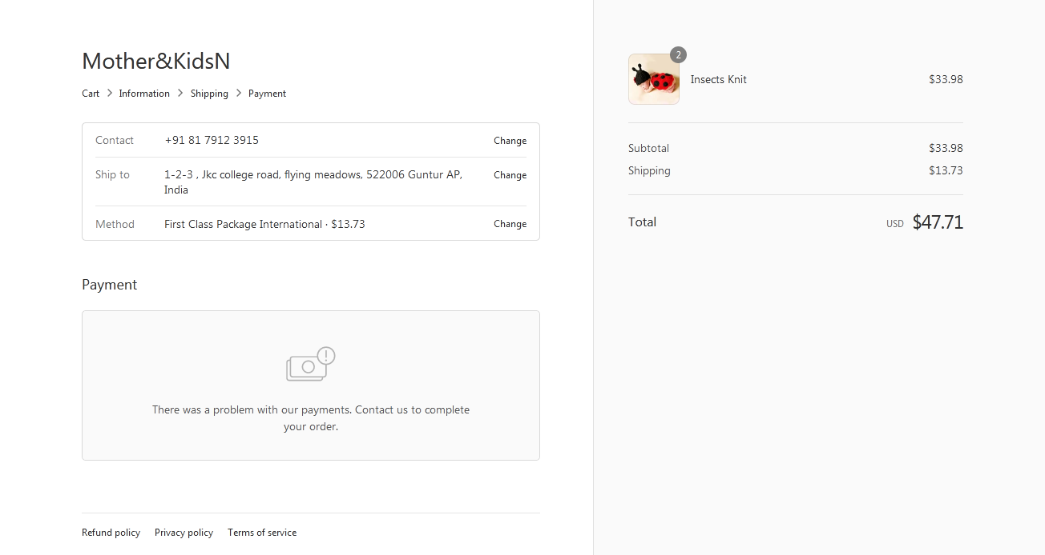

Slide 23
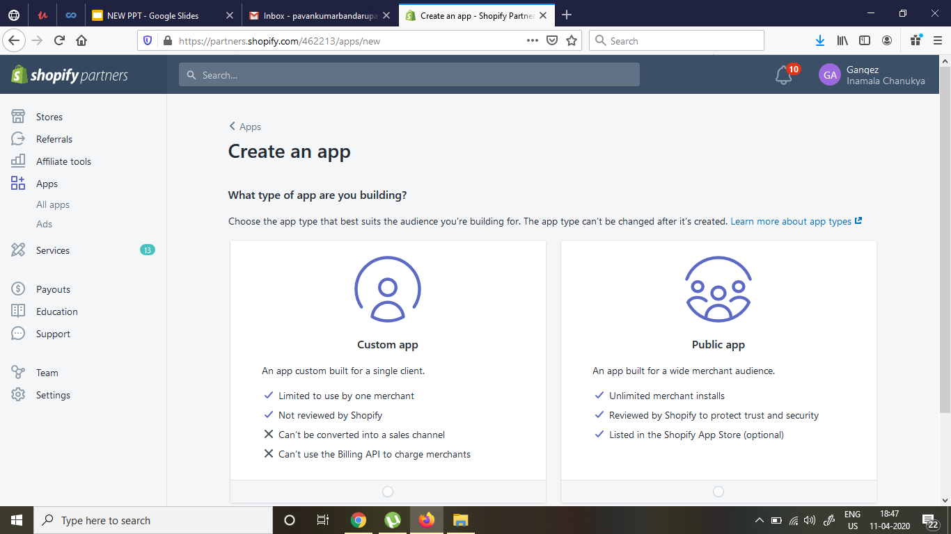
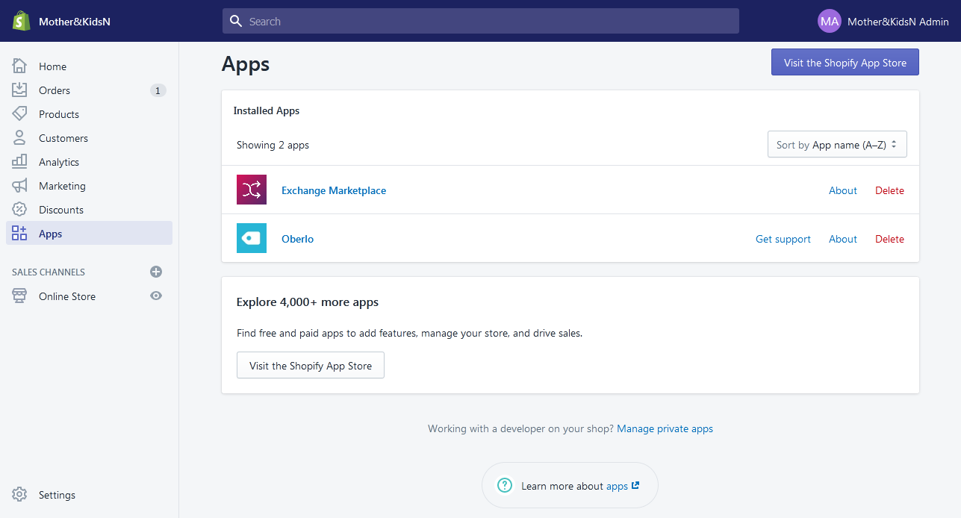
APPS
An app is a computer program that is designed for use on a mobile digital device.

Slide 24
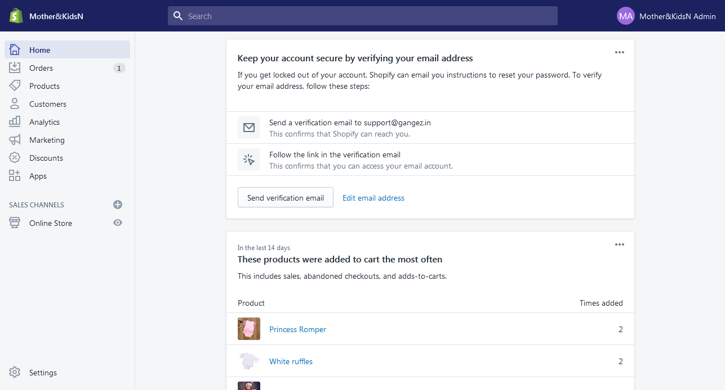
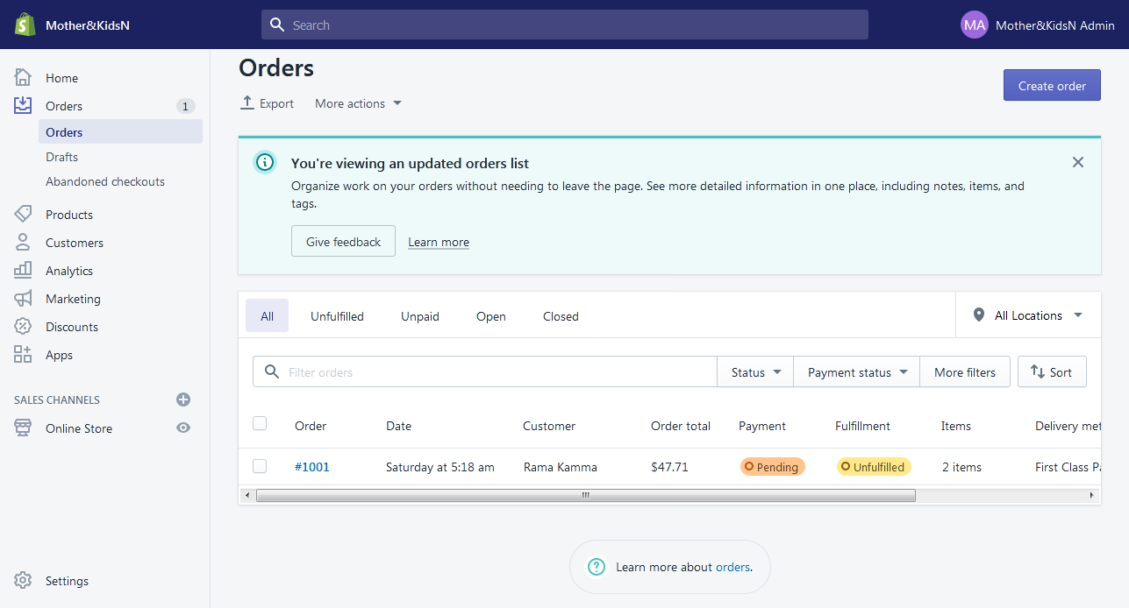
HOME
This section defines what’s within the store.You find pages in the Shopify admin or search our most popular help documentation and blog posts.
ORDERS
Create orders manually in your Shopify admin to record orders that you've made outside of Shopify or to send your customers email invoices.

Slide 25
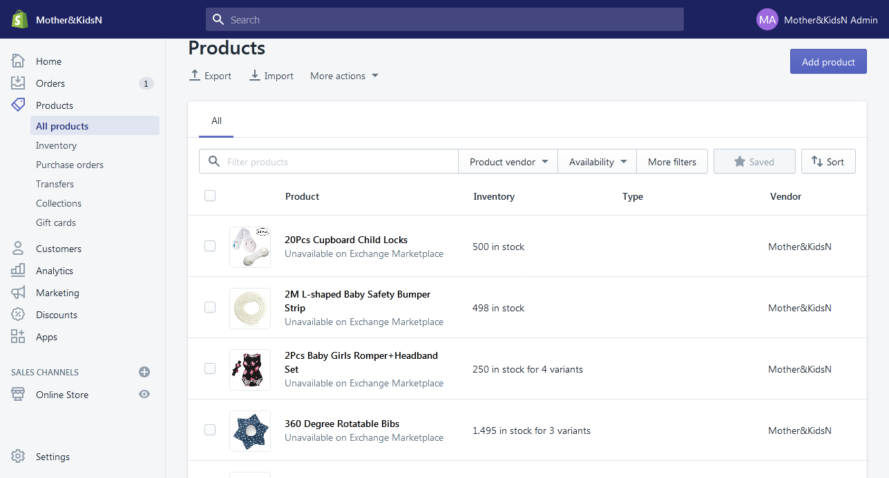
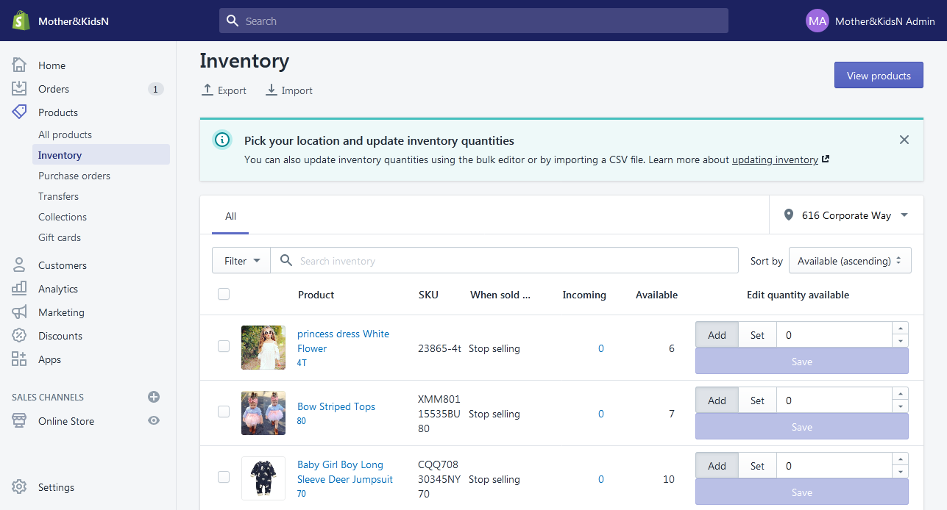
PRODUCTS
Your products are the goods, digital downloads, services, and gift cards that you sell. You add a product in Shopify by entering product details and uploading product images.
INVENTORY
Inventory is the quantity of a particular product that is available for sale.Inventory tracking can help you avoid selling products that have run out of stock, or let you know when you need to order.

Slide 26
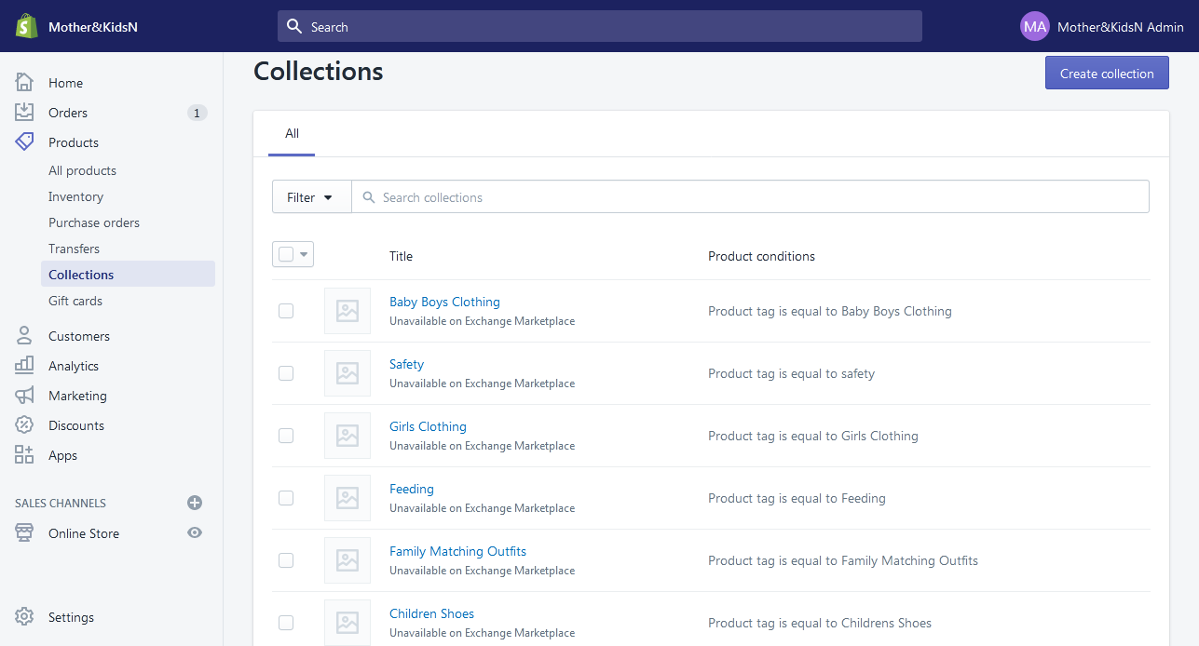
COLLECTIONS
We can group our products into collections to make it easier for the customers to find them by category.We can add up to 60 selection conditions.

Slide 27
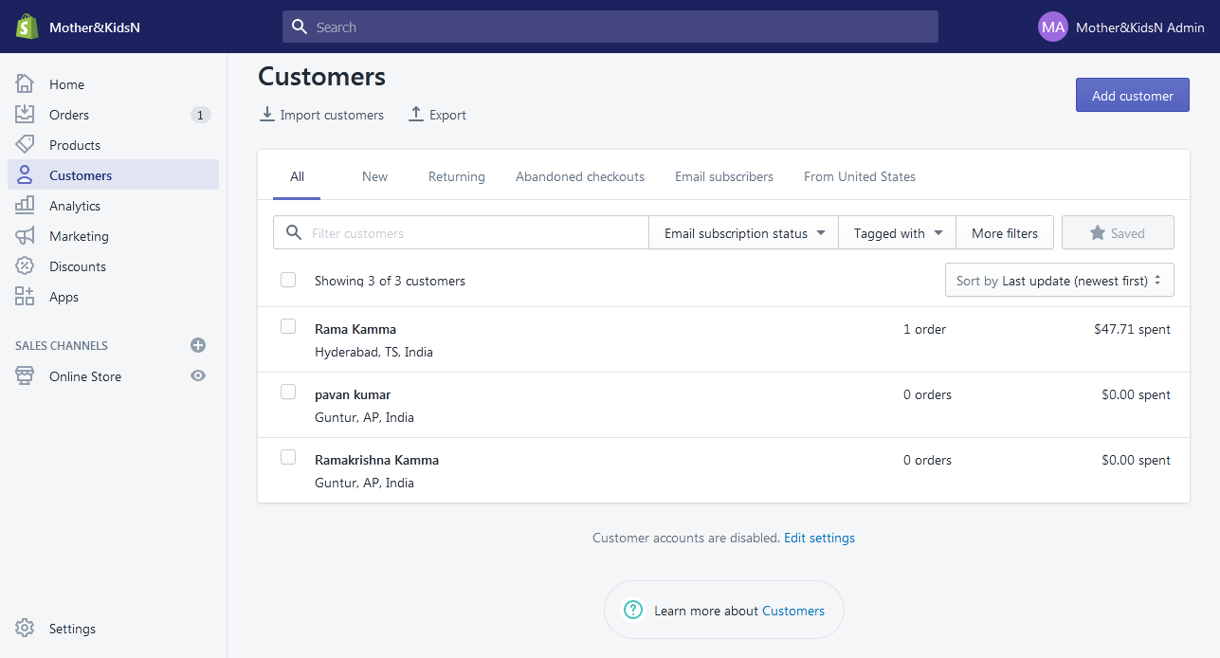
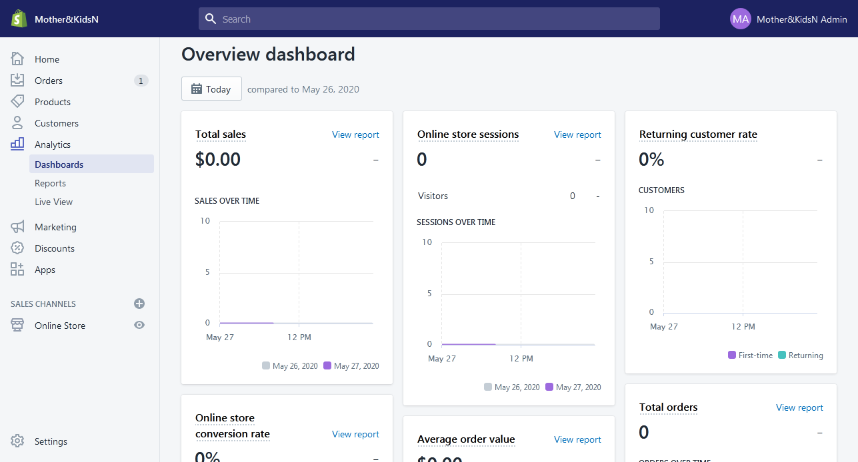
CUSTOMERS
Interacting with your customers is an important part of running your business.If your customers create an account with your store, then they can add their address information to their account so that it autofills during checkout.
ANALYTICS
We can use Shopify's analytics and reports to learn about our sales and customers in great detail.We can also set up third-party analytics services, such as Google Analytics.

Slide 28
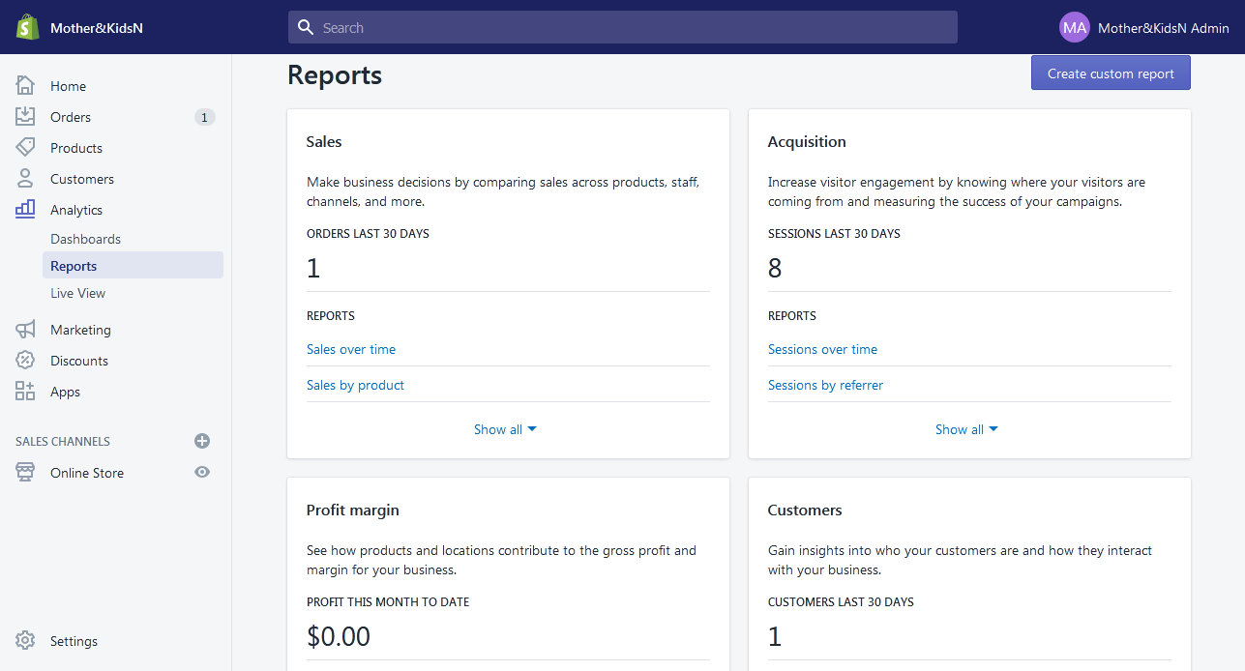
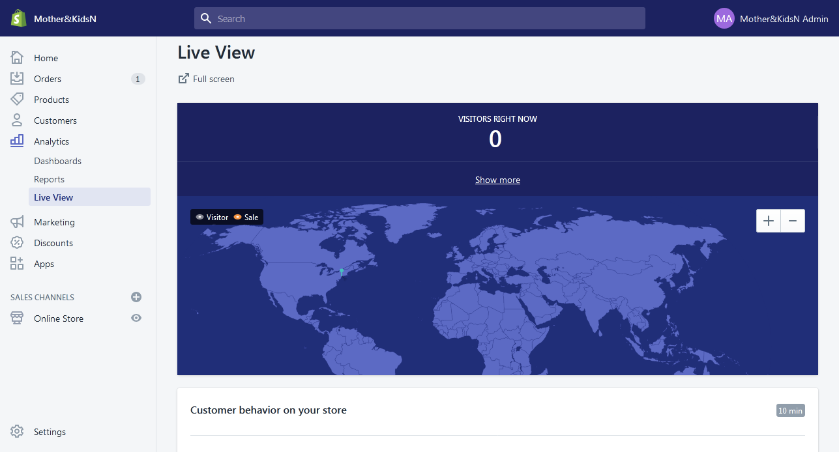
REPORTS
In this section, we can see reports for the inventory, orders and sales of our store.
LIVE VIEW
Live View gives us a real-time view of the activity of our store. Live View includes a world map to show us where the activity of our store is coming from.

Slide 29
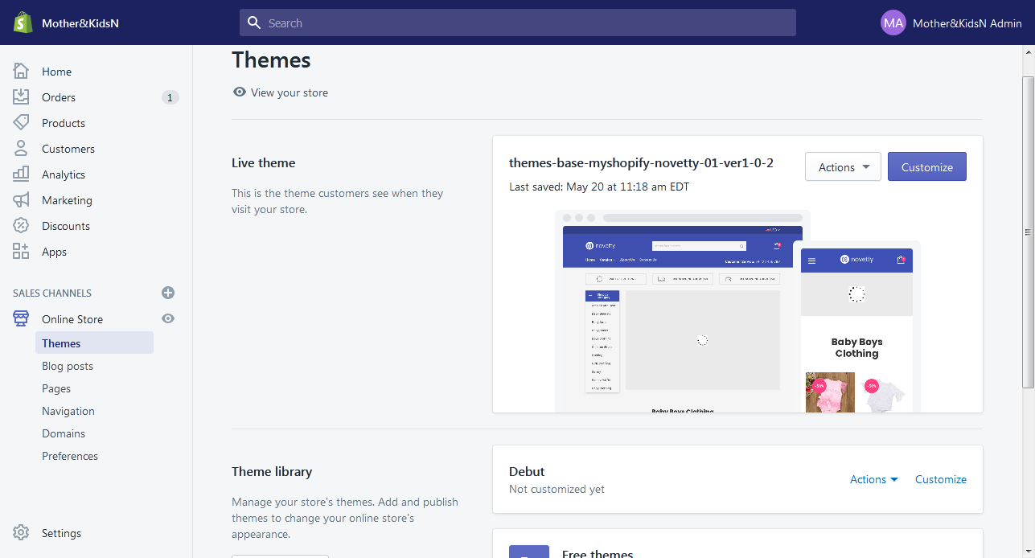
THEMES
Shopify Themes control the appearance of merchants’ online stores. Developers can use Shopify’s open-source Liquid templating language, along with standard HTML, CSS, and JavaScript, to create any look and feel their clients want.

Slide 30
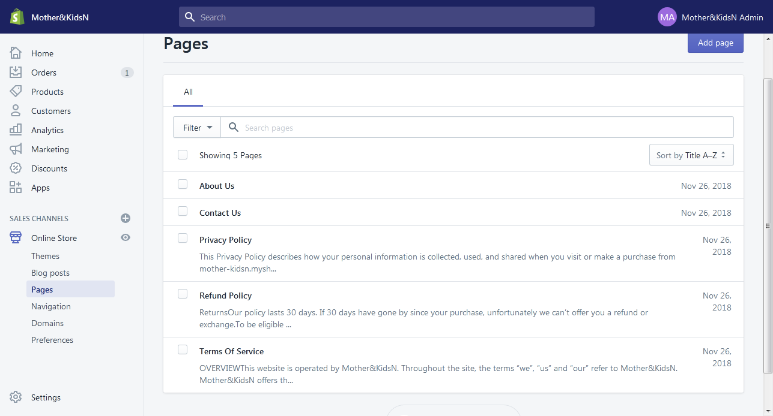
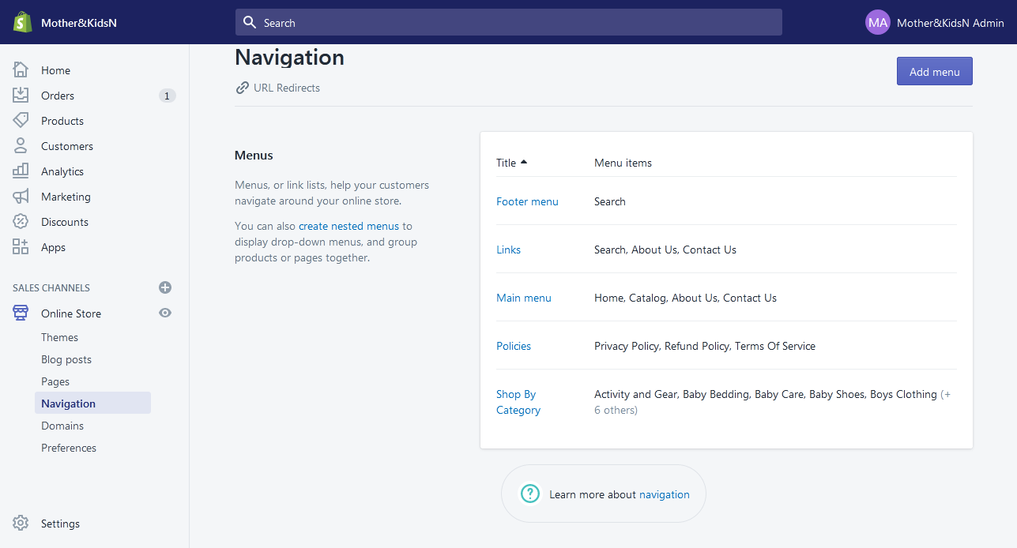
PAGES
Web pages contain information that rarely changes or that customers will reference often, like an "About Us" page or a "Contact Us" page.
NAVIGATIONS
Navigations helps your customers to find your products and information about your business. Your online store has two default menus that appear on every page: the main menu and the footer menu.

Slide 31
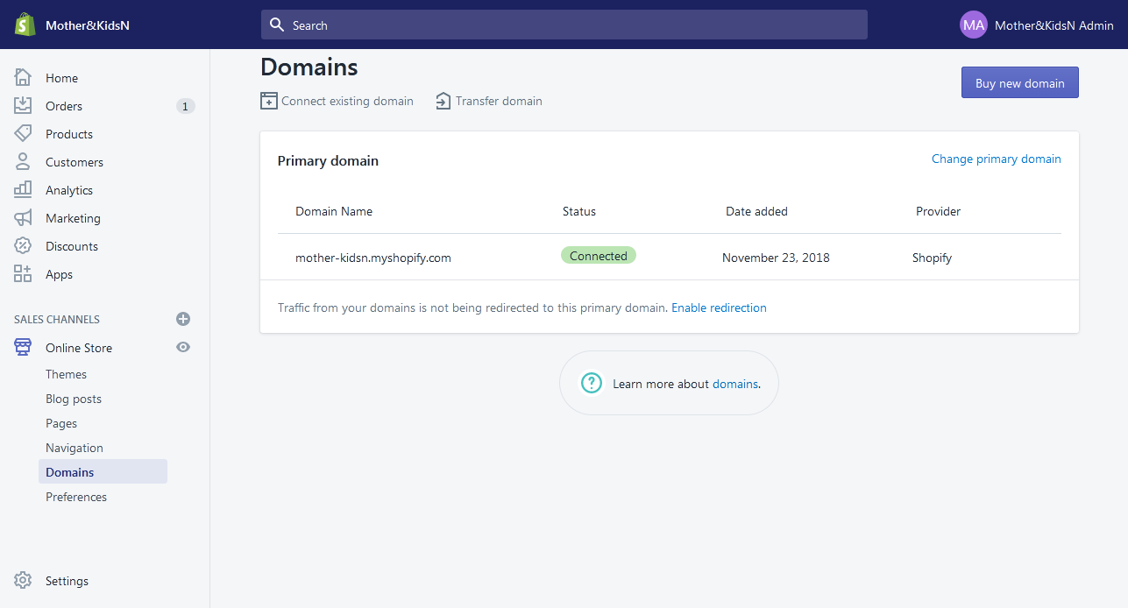
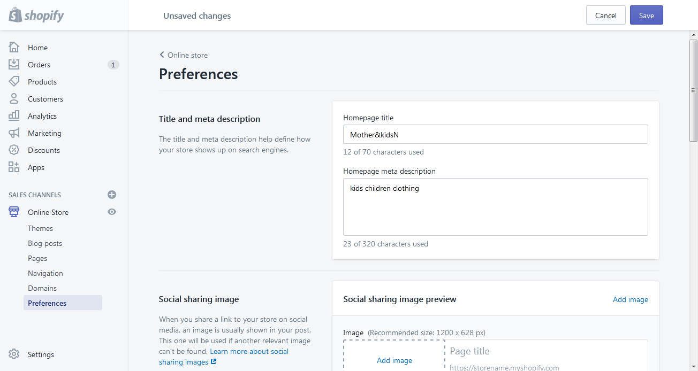
DOMAIN
A Domain is the URL, or the website address, where your customers go to find your store online. You manage your domain settings for your online store on the Domains page in your Shopify admin.Your primary domain looks like your-store-name.myshopify.com .
PREFERENCES
You can edit the title and meta description of your online store, add tracking codes, or enable a password page or checkout protection on the Preferences page.

Slide 32
REFERENCES
Shopify help documentation : https://help.shopify.com/
Shopify Community : https://ecommerce.shopify.com/
Responsive design : https://responsivedesign.is/guidelines/flexible-grid-based- layouts
Liquid Basics - https://help.shopify.com/themes/liquid/basics.
Theme Development -https://help.shopify.com/themes/development.

Slide 33


